Slide 1
INVENTORY CONTROL MANAGEMENT DATABASE

Slide 2

AGENDAS:-
CMDB Introduction
Data Integration
Data Relationship
Demo
Reports Mobility

Slide 3
HELLO!L
I am Sagar Sharma(Team Lead)
My peers:-
Debashish Mittra
Manraj Singh Sandhu
Manpreet Kaur Ratol

Slide 4

What is CMDB?
Configuration management databases (CMDBs) are often referred to as “the heart of your ITSM system”. A CMDB is a repository that acts as a data warehouse – storing information about your IT environment, the components that are used to deliver IT services.
The data stored in a CMDB include lists of assets (referred to as configuration items) and the relationships among them.

Slide 5
CMDB ADVANTAGE
Integration
Having a complete set of data about your IT environment in a centralized place so you can easily access it.
Stats
Providing information to support decision making about the IT environment, operational costs and technology decisions.
Relational Structure
Understanding what different assets are used for and which business processes and users depend on them.

Slide 6
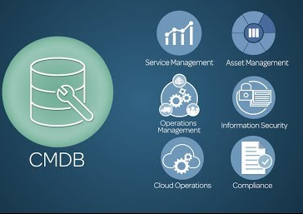
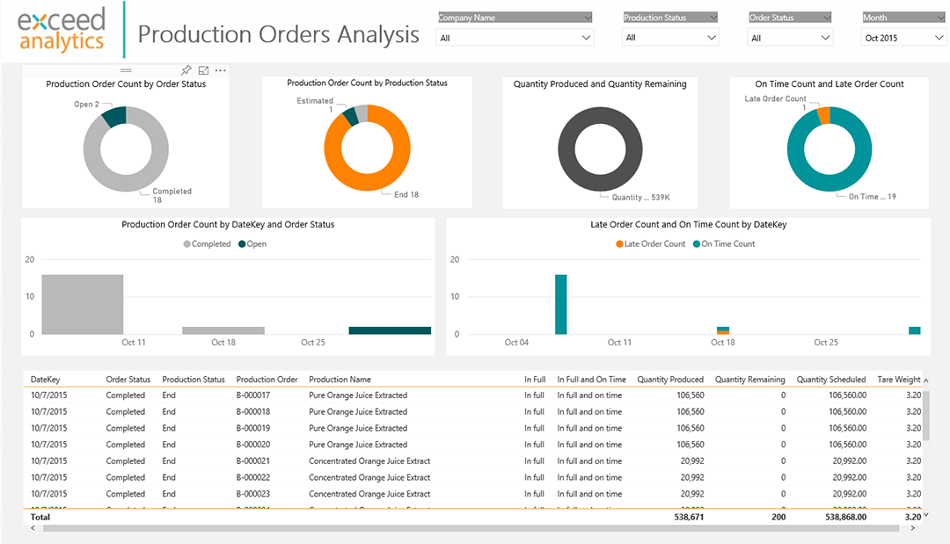
CMDB COMPLIANCE
CMDB
Reports
Generation
Infrastructure
Discovery
Configuration Items

Slide 7
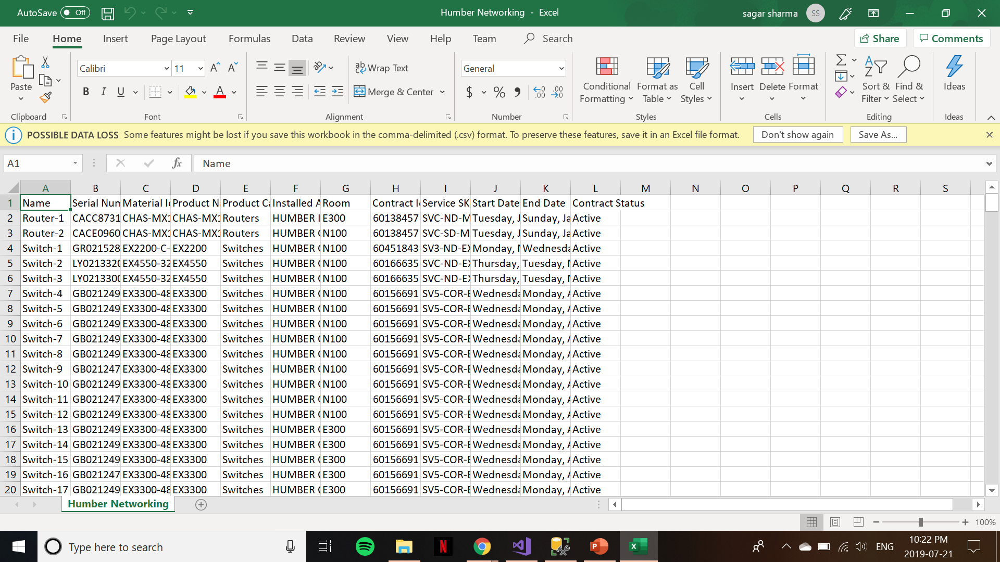
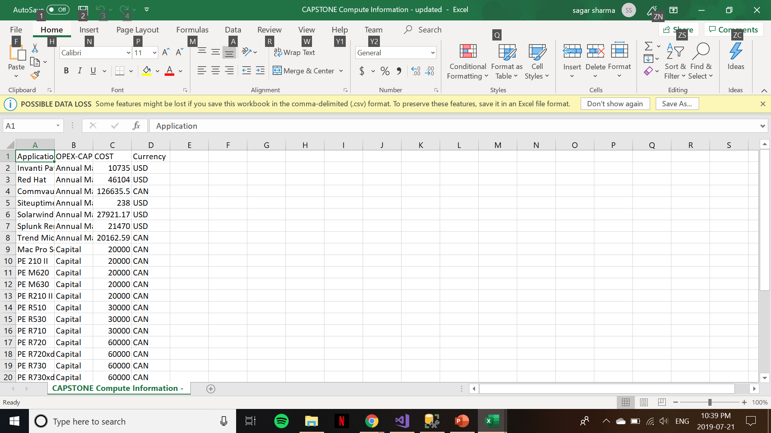
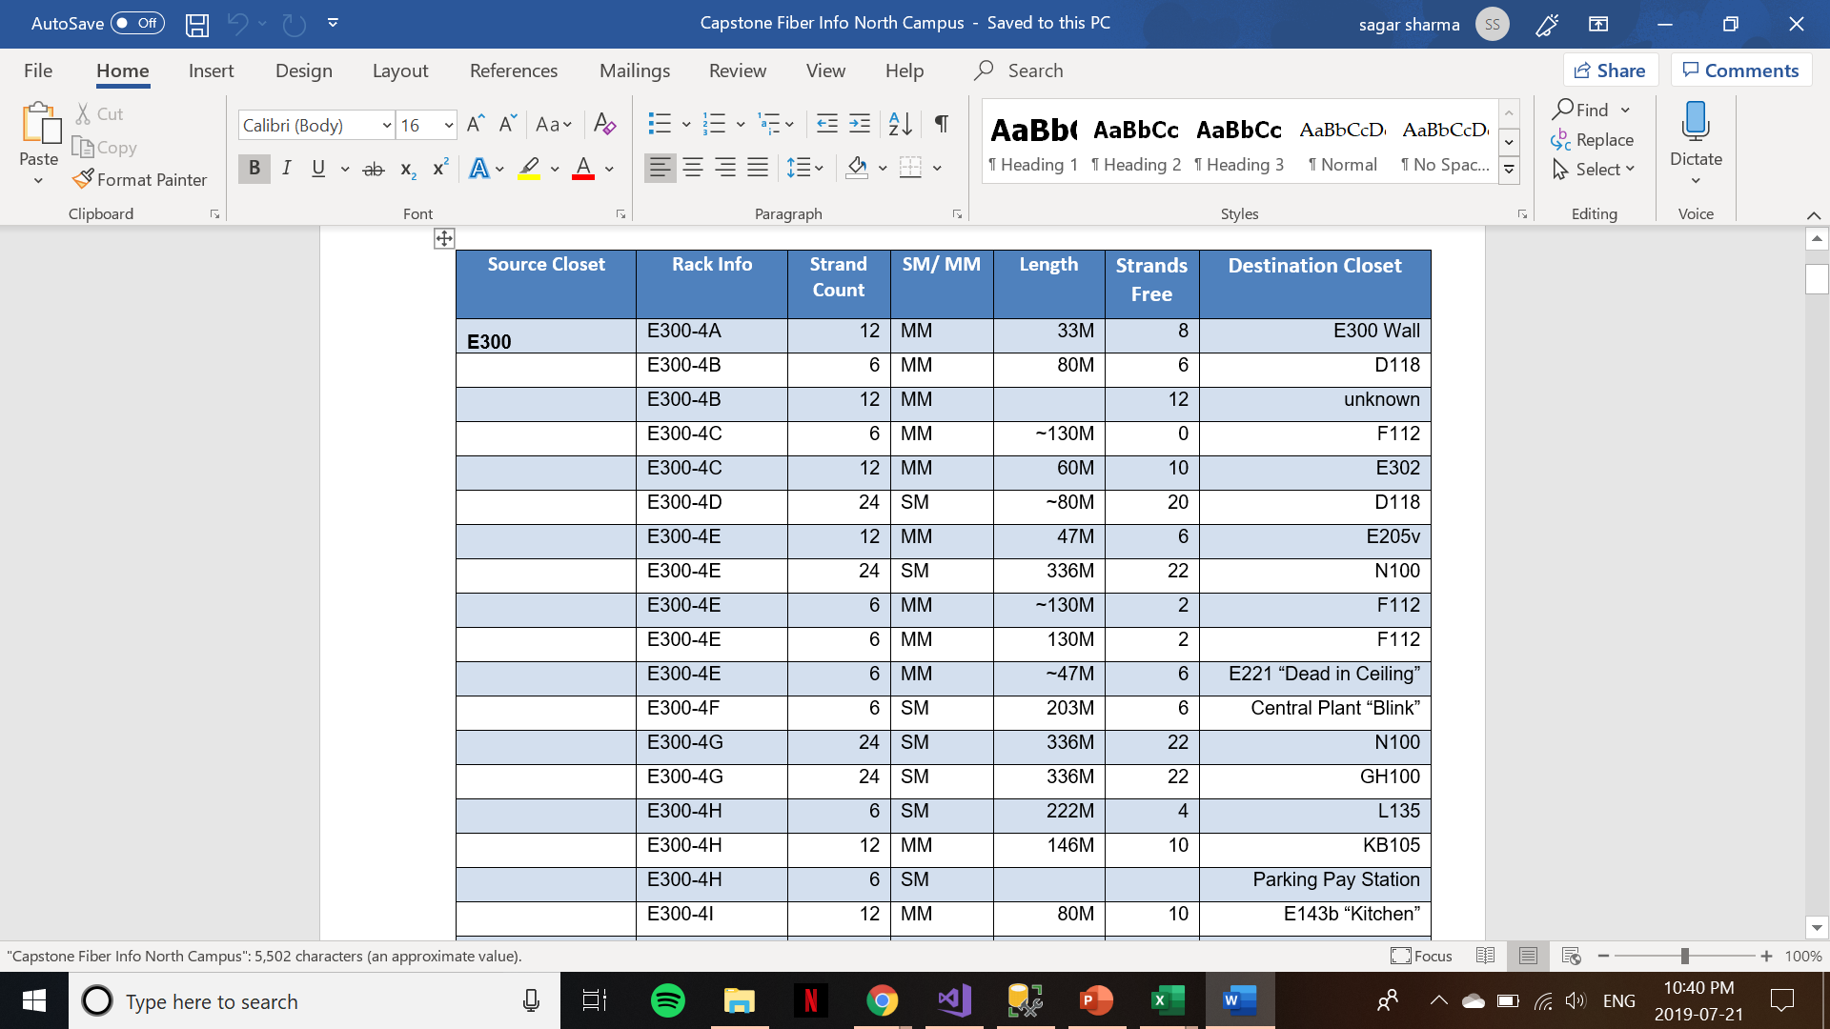
RESOURCES
Data was given about the networking components installed throughout Humber College such as Routers and Switches.
Multiple flat files were given in .csv format and word format

Slide 8
1.
DATA INTEGRATION
Building enterprise-level data transformations
solutions.

Slide 9
Import Data
Manual
We used SSMS importing tool to import data from .csv file
Before executing complex SQL queries on CSV files, we need to convert CSV files to data tables.
Auto Import SSIS
We also used auto import in the later part of the project through Integration services.
We can set up scheduled importing through it.
ETL eases up insertion and transforms data.

Slide 10
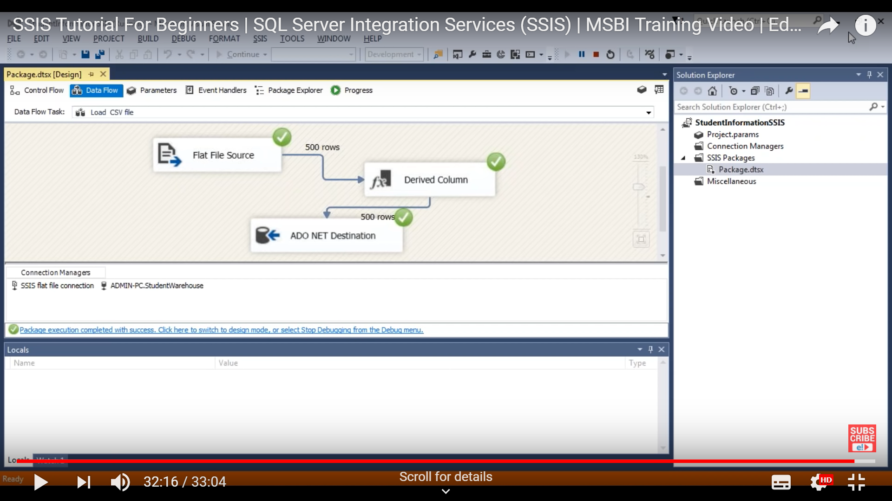
Data Integration through SSIS

Slide 11
DATA RELATIONSHIP

Slide 12
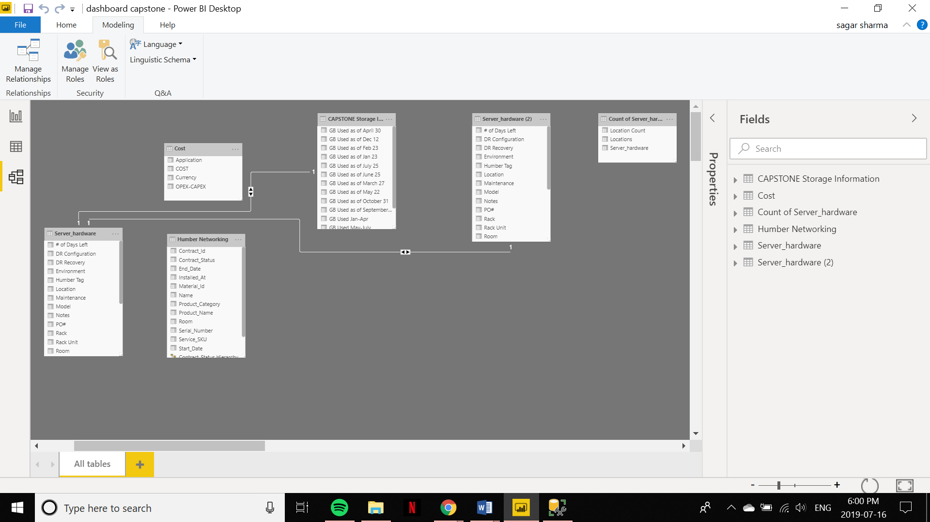

Slide 13

REPORT GENERATION
Report Server gives your users access to rich, interactive reports, and the enterprise reporting capabilities of SQL Server Reporting Services. Explore visual data and quickly discover patterns to make better, faster decisions.

Slide 14
GENERATION
TOOLS USED:-
Report Builder:- We created some static reports for initial phase of the project, just to see how can we progress further.
Power BI:- For the later part of the project we used this tool to create more dynamic reports with user-friendly dashboard.

Slide 15
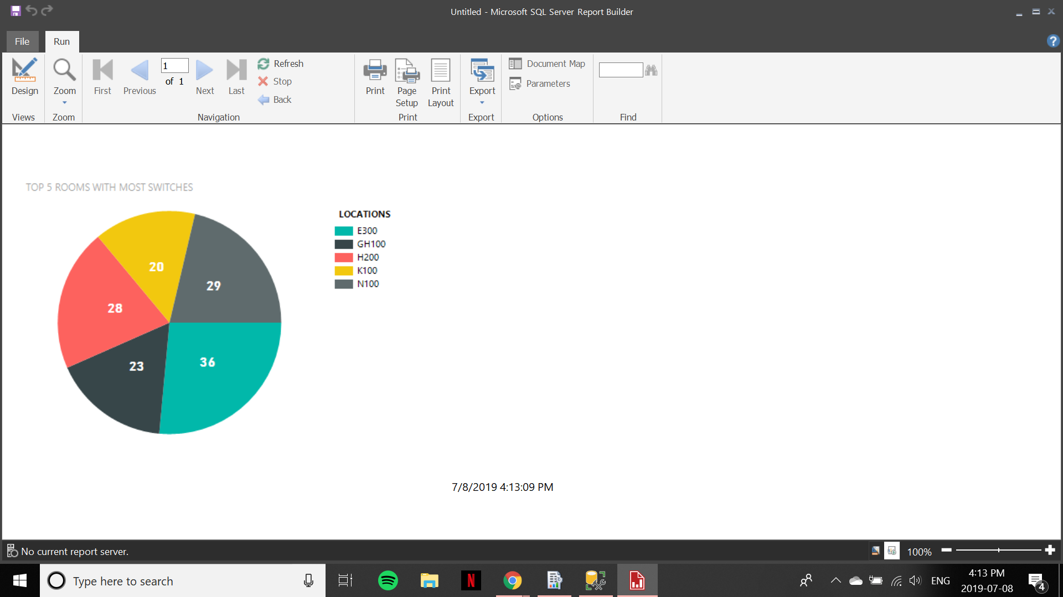
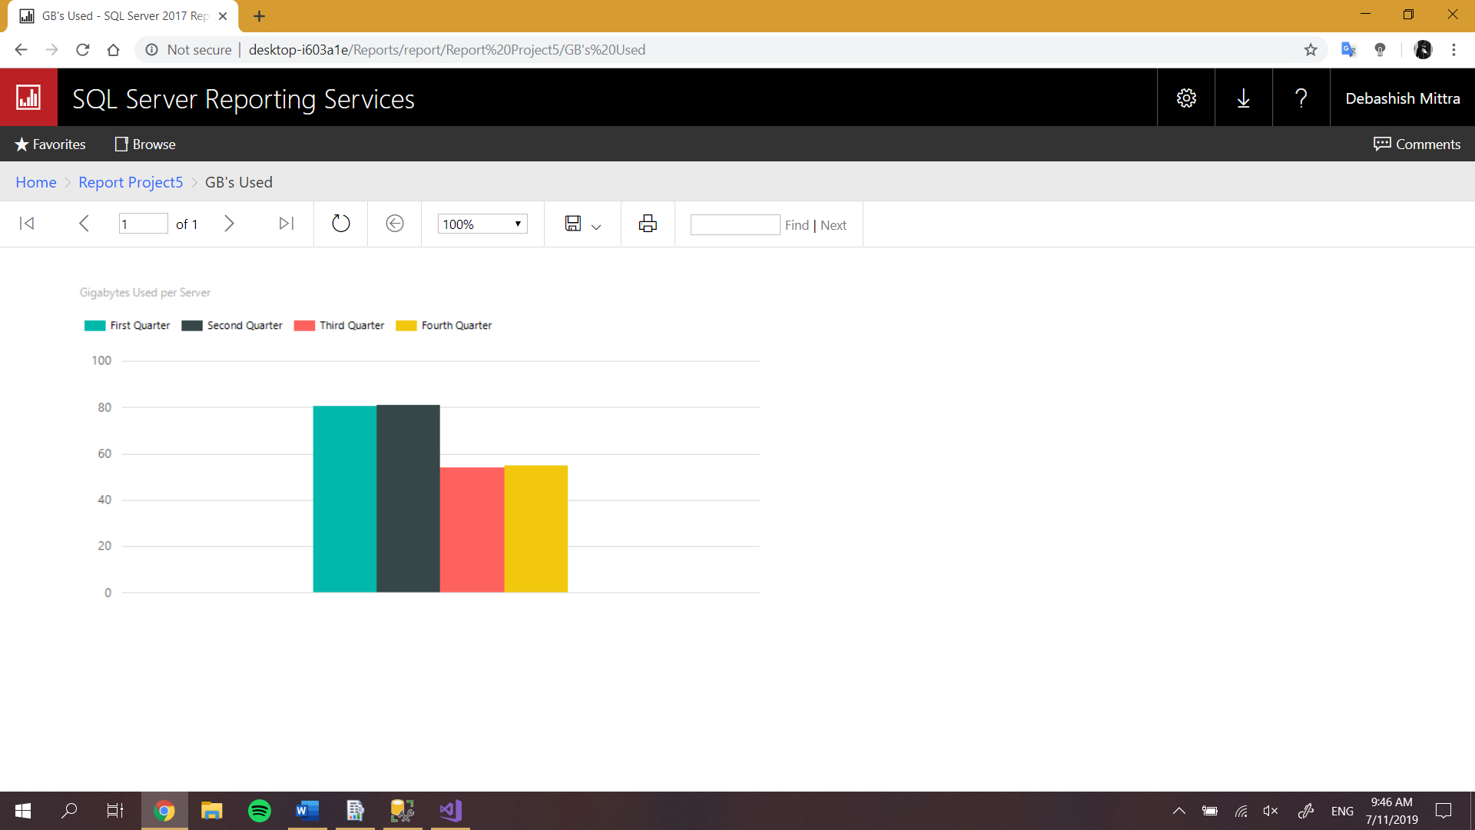
INITIAL REPORTS

Slide 16
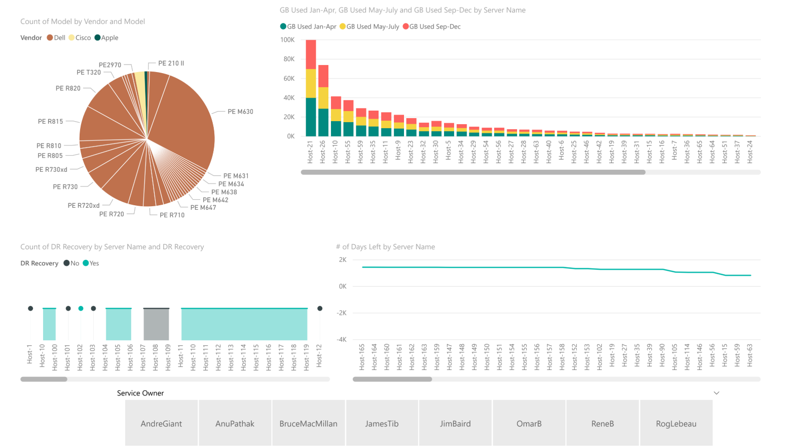
Final Dashboard

Slide 17
MAPS
Humber North
Server hardware: 143

Slide 18
DEMO
With navigation buttons we can hop onto different pages of dashboard.

Slide 19
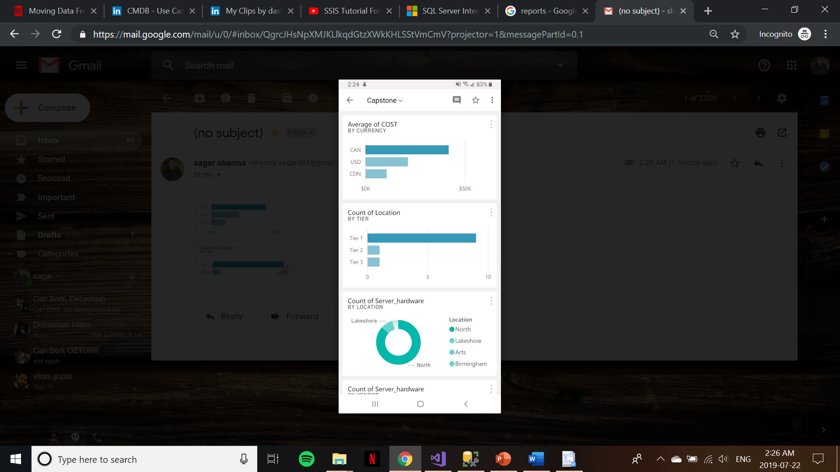
REPORTS
MOBILITY
With the integration of mobile app we can see various phone oriented reports.
Place your screenshot here

Slide 20
THANKS!
You can find me at:
sharma.sagar504@gmail.com

